Slide 1
COMPLEXITY CLASSES
Dr.P.Vetrivelan
VIT Chennai

Slide 2
References
Alfred V. Aho, Rajeev Motwani, Jeffrey D. Ullman, “Introduction to Automata Theory, Languages and Computation”, Pearson Education.
John C Martin, “Introduction to Languages and Theory of Computation”, Tata Mc Graw Hill.
Michael Sipser, ”Theory of Computation”, Thompson learning.
Online lectures.

Slide 3
Computational Complexity
Agenda:
Introduction to Algorithm
Analysis of Algorithm
  Asymptotic Analysis
  Order of Growth
  Asymptotic Notations
    Big Oh (Ο)
    Big Omega (Ω)
    Big Theta (Θ)
Practical Complexity Classes

Slide 4
Introduction: Algorithm
ALGORITHM
Input (DATA)
Output (Results)
An algorithm is a well-defined computational procedure that
  takes some values (data) as “input”
  produces some result as “output”
Data structure
  Methods of organizing the data
A famous quote
  Program = Algorithm + Data structure

Slide 5
Introduction: Algorithm
More precisely, an algorithm is a method or process to solve a problem satisfying the following properties:
  Finiteness
    terminates after a finite number of steps
  Definiteness
    Each step must be rigorously and unambiguously specified.
  Input
    Valid inputs must be clearly specified.
  Output
    can be proved to produce the correct output given a valid can be proved to produce the correct output given a valid input.
  Effectiveness
    Steps must be sufficiently simple and basic.

Slide 6
Introduction: Problem
An instance of a problem consists of all inputs needed to compute a solution to the problem.
An algorithm is said to be correct if for every input instance, it halts with the correct output.
A correct algorithm solves the given computational problem. An incorrect algorithm might not halt at all on some input instance, or it might halt with other than the desired answer.

Slide 7
Methods of Specifying an Algorithm
Natural language
  Ambiguous
Pseudo code
  A mixture of a natural language and programming language - like structures
  Precise and succinct.
  Pseudo code in this course
    omits declarations of variables
    use indentation to show the scope of such statements as for, if, and while.
    use ← for assignment

Slide 8
Fundamentals of Algorithmic Problem Solving
Understanding the problem
  Asking questions, do a few examples by hand, think about special cases, etc.
Deciding on
  Exact vs. approximate problem solving
  Appropriate data structure
Design an algorithm
Proving correctness
Analyzing an algorithm
  Time efficiency : how fast the algorithm runs
  Space efficiency: how much extra memory the algorithm needs.
Coding an algorithm

Slide 9
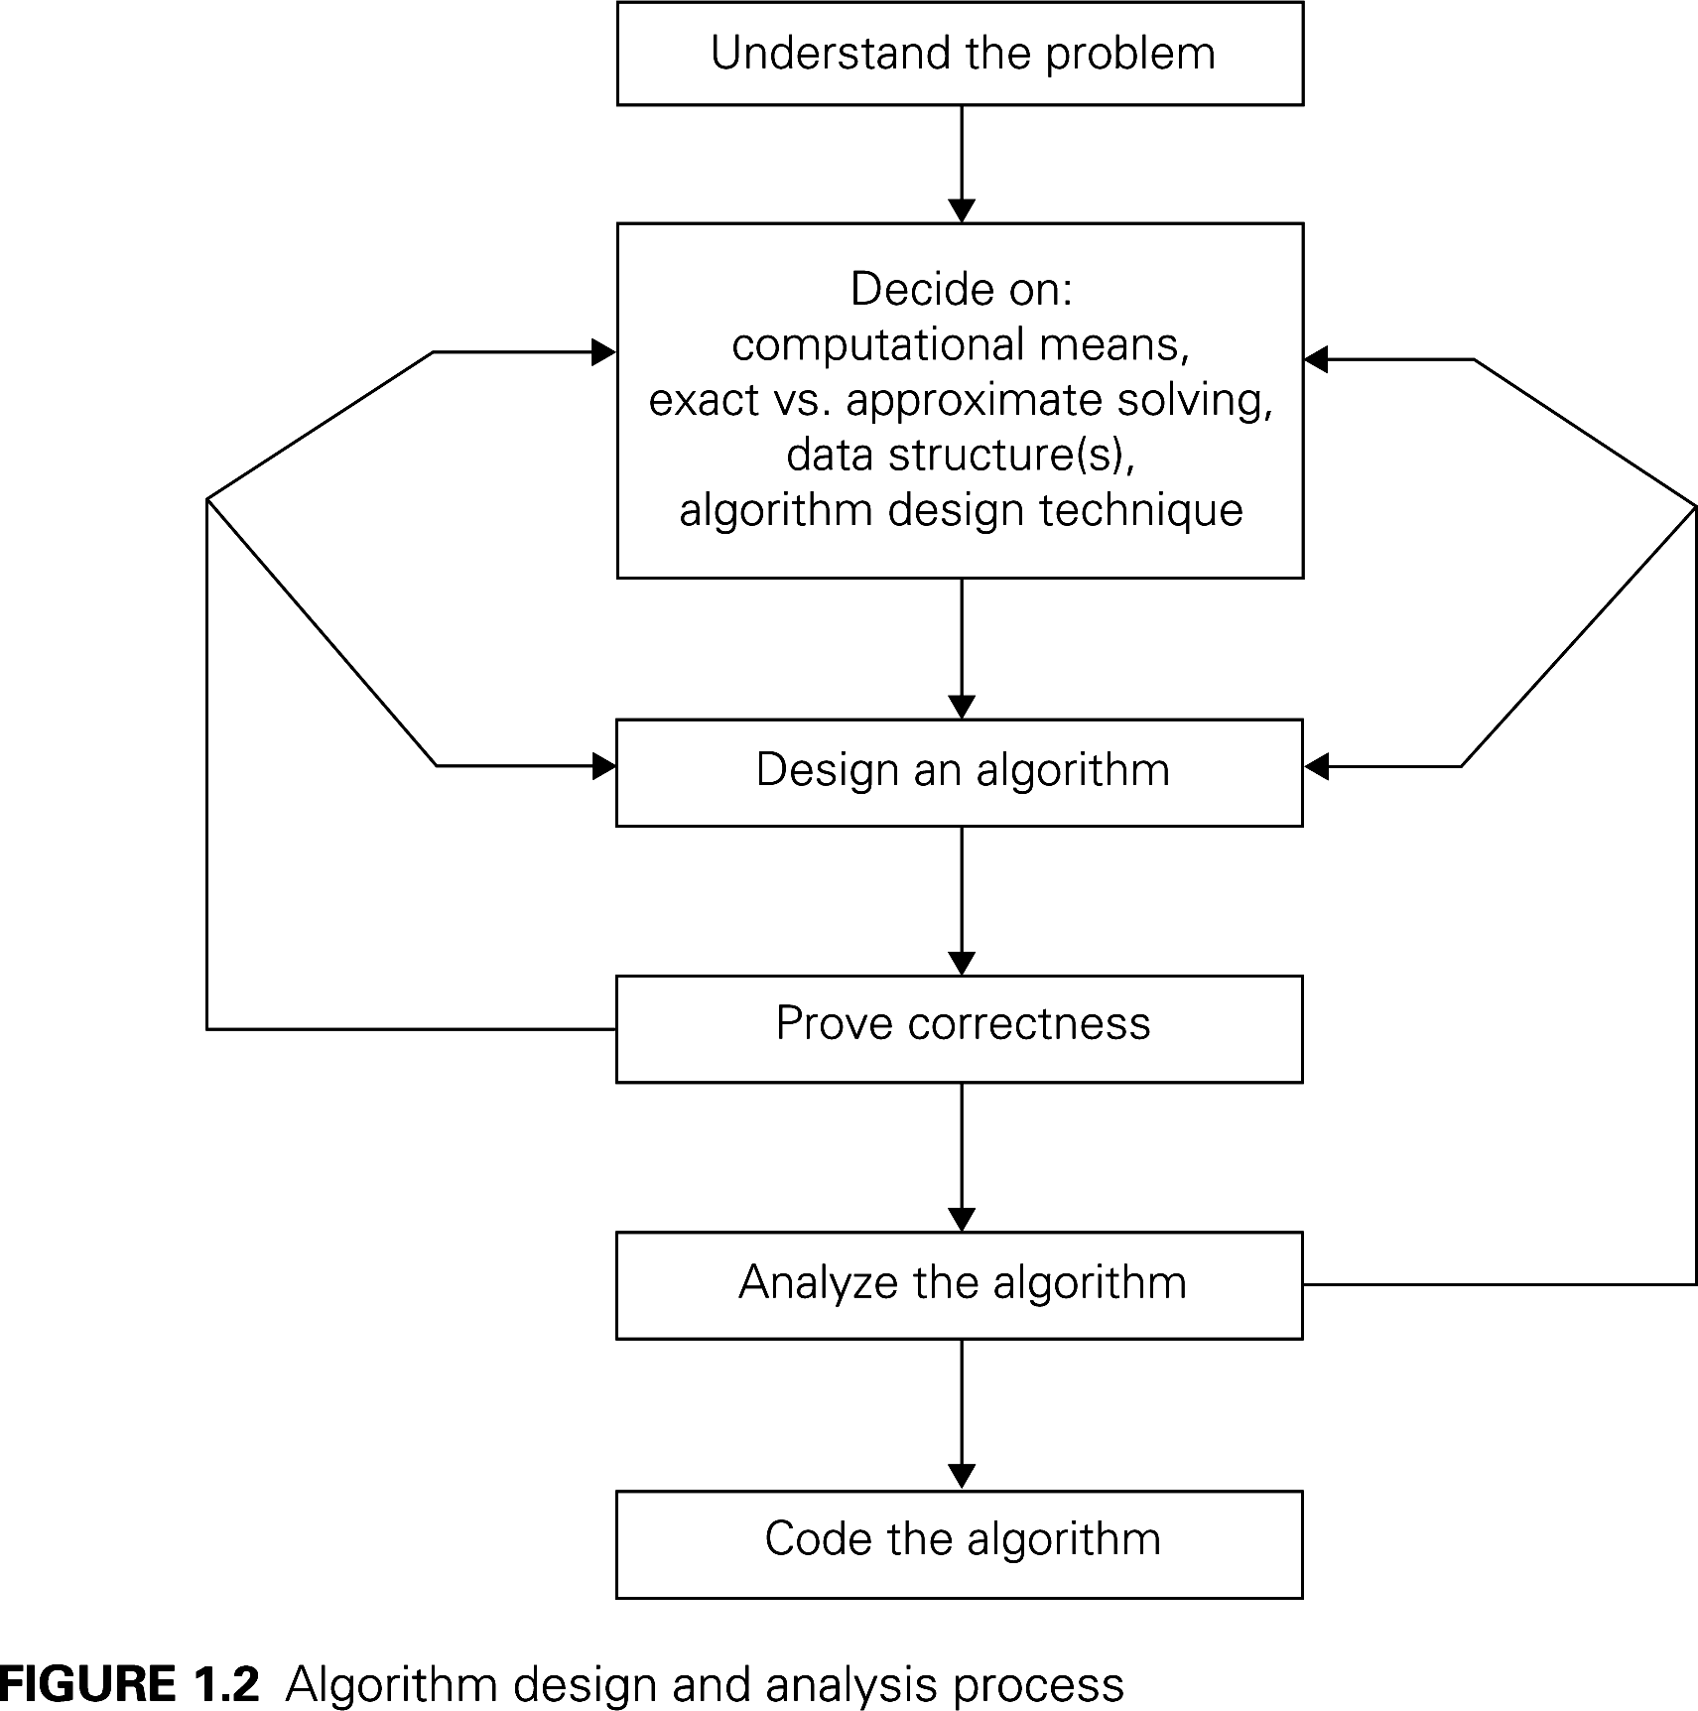
Fundamentals of Algorithmic Problem Solving

Slide 10
Two main issues related to algorithms
How to design algorithms
How to analyze algorithm efficiency

Slide 11
Algorithm Design Techniques/Strategies
Brute force
Divide and conquer
Decrease and conquer
Transform and conquer
Greedy Approach
Dynamic Programming
Backtracking
Branch and Bound

Slide 12
Analysis of Algorithms
How good is the algorithm?
  time efficiency
  space efficiency
Does there exist a better algorithm?
  lower bounds
  optimality

Slide 13
Why Analyze Algorithms?
An algorithm can be analyzed in terms of time efficiency or space
utilization. We will consider only the former right now. The running
time of an algorithm is influenced by several factors:
Speed of the machine running the program
Language in which the program was written. For example, programs written in assembly language generally run faster than those written in C or C++, which in turn tend to run faster than those written in Java.
Efficiency of the compiler that created the program
The size of the input: processing 1000 records will take more time than processing 10 records.
Organization of the input: if the item we are searching for is at the top of the list, it will take less time to find it than if it is at the bottom.

Slide 14
How do we analyze algorithms?
We need to define a number of objective measures.
(1) Compare execution times?
Not good: times are specific to a particular computer !!
(2) Count the number of statements executed?
Not good: number of statements vary with the programming language as well as the style of the individual programmer.
Notes:
Discrete Mathematics and its Applications
26年 11月 8日
(c)2001-2002, Michael P. Frank

Slide 15
How do we analyze algorithms?
(3) Express running time as a function of the input size n (i.e., f(n)).
  To compare two algorithms with running times f(n) and g(n), we need a rough measure of how fast a function grows.
  Such an analysis is independent of machine time, programming style, etc.
Notes:
Discrete Mathematics and its Applications
26年 11月 8日
(c)2001-2002, Michael P. Frank

Slide 16
Computational complexity
Two kinds of computational complexity:
  Time complexity –
  How fast the algorithm runs?
  Space complexity –
  How much extra space does the algorithm requires?

Slide 17
Measuring complexity
An algorithm’s efficiency is principally measured as a function of its input size.
Input size (number of elements in the input)
  size of an array
  polynomial degree
  # of elements in a matrix
  # of bits in the binary representation of the input
  vertices and edges in a graph

Slide 18
Complexity Measures
Three different ways of measuring the time complexity is:
  Worst case
  Best case
  Average case
Time efficiency is measured as a function of its input size by counting the number of times the basic operation is executed.
Basic operation is the most time consuming operation in the algorithms.

Slide 19
Complexity Measures
Worst-case analysis:
  The worst-case input of size n for which the algorithm runs the longest time among all possible input.
  Provides an upper bound on running time.
Best-case analysis:
  The best-case input of size n for which the algorithm runs the fastest among all possible input.
  Provides a lower bound on running time.
Average-case analysis:
  Provides a prediction about the running time.
  Assumes that the input is random.

Slide 20
Determination of Complexities
How do you determine the running time of piece of code?
Ans : Depends on the kinds of statements used

Slide 21
1. Sequence of Statements
Statement 1;
Statement 2;
…
…
Statement k;
Independent statement in a piece of code and not an unrolled loop
Total Time : Adding the time for all statements.
Total Time = Time (Statement 1) + Time (Statement 2) + … + Time (Statement k)
Each statement – simple (basic operations) – Time constant – Total time is also constant O(1)

Slide 22
2.If-then-else statements
If(cond) {
Sequence of statements 1
}
Else
{
Sequence of statements 2
}
Either Sequence 1 or Sequence 2 will execute.
Worst Case Time is slowest of two possibilities
  Max { time (sequence 1), time (sequence 2) }
  If Sequence 1 is O(N) and Sequence 2 is O(1), Worst case time for if-then-else would be O(N)

Slide 23
3.For loops
for (i=0; i<N;i++)
{
Sequence of statements
}
Loop executes N times, Sequence of statements also executes N times.
Total time for the for loop = N*O(1) = O(N)

Slide 24
4.Nested Loops
For (i=0;i<N;i++){
for(j=0;j<M;j++){
sequence of statements;
}
}
Total Complexity = O(N*M)
= O(N²)

Slide 25
5.Statement with function calls
F(k) method – take constant time O(1)
for (j=0; j<N; j++) g(N); has complexity O(N²)
  Loop executes N times
  g(N) has complexity O(N)

Slide 26
Prob 1.Calculate worst-case complexity!
2 loops in a row
For (i=0;i<N;i++)
Sequence of Statements;
}
For (j=0;j<M;j++)
Sequence of Statements;
}

Slide 27
How complexity changes if M=N?
O(N), O(M) = O(N+M) = O(max(M,N)
M=N
O(N+M) = O(2N) = O(N)
Constants and lower order terms can be dropped

Slide 28
Prob 2.Calculate worst-case complexity!
Nested Loop + Non-nested loop
for (i=0;i<N;i++){
for(j=0;j<N;j++){
sequence of statements;
}
}
for(k=0;k<N;j++){
sequence of statements;
}
O(N²), O(N) = O(max(N²,N) = O(N²)

Slide 29
Prob 3.Calculate worst-case complexity!
Nested Loop
for (i=0;i<N;i++){
for(j=i;j<N;j++){
sequence of statements;
}
}
N+ (N-1) + (N-2) + …. + 1 = N(N+1)/2 = O(N²)

Slide 30
Importance of constants during analysis
In Big-Oh notation, we drop constant and low order terms
When problem size gets sufficiently larger, these terms doesn’t matter
Ex : Algorithm 1 .. N² time
Algorithm 2 .. 10*N² + N
For both , Time is O(N²) but Alg 1 faster than Alg 2
When Algorithm scales, constants do not matter!!
If Problem size doubles, Actual Time will quadruple

Slide 31
Best, Average and Worst Case Complexity
In some cases, it is important to consider the best, worst and/or average (or typical) performance of an algorithm.
For example, when sorting a list into order, if it is already in order then the algorithm may have very little work to do. (Best case)
The worst-case analysis gives a bound for all possible inputs (and may be easier to calculate than the average case)

Slide 32
Linear Search Algorithm
Input: An array of n numbers and an element which is required to be searched in the given list
Output: Number exists in the list or not.
Algorithm:
1. Input the size of list i.e. n
2. Read the n elements of array A
3. Input the item/element to be searched in the given list.
4. for each element in the array i=1 to n
5. if A[i]==item
6. Search successful, return
7. if i==n+1
8. Search unsuccessful.
9. Stop

Slide 33
Complexity Analysis of Linear Search
Worst Case : O(n)
  element to be searched is either not in the list or found at the end of the list
  algorithm runs for longest possible time i.e maximum running time of the algorithm depends on the size of an array
Best Case : O(1)
  element to be searched is found at first position in the list
  gives minimum running time for an algorithm
Average Case : O(n)
  element could be found at random position in the list
  probability of occurrence of all possible input is equal i.e array elements could be in any order

Slide 34
Practical complexities
1 (constant): growth is independent of the problem size n.
log₂N (logarithmic): growth increases slowly compared to the problem size (binary search)
N (linear): directly proportional to the size of the problem.
N * log₂N (n log n): typical of some divide and conquer approaches (merge sort)
N² (quadratic): typical in nested loops
N³ (cubic): more nested loops
N^{k} (polynomial)
2^{N} (exponential): growth is extremely rapid and possibly impractical.
N! (factorial): growth is extremely rapid and possibly impractical.

Slide 35

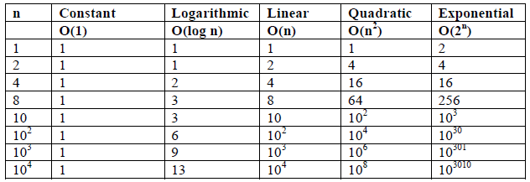
EFFICIENCY COMPARISONS

Slide 36
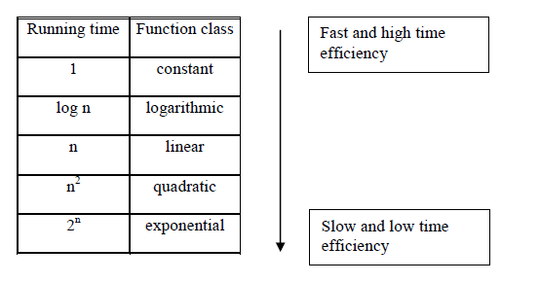
EFFICIENCY COMPARISONS

Slide 37
1 (Constant Time)
When instructions of program are executed once or at most only a few times , then the running time complexity of such algorithm is known as constant time.
it is independent of the problem size. It is represented as O(1).
For example, linear search best case complexity is O(1)

Slide 38
Log n (Logarithmic)
The running time of the algorithm in which large problem is solved by transforming into smaller sizes sub problems is said to be Logarithmic in nature.
Becomes slightly slower as n grows.
It does not process all the data element of input size n.
The running time does not double until n increases to n².
It is represented as O(log n).
For example binary search algorithm running time complexity is O(log n).

Slide 39
n (Linear)
The complete set of instruction is executed once for each input i.e input of size n is processed.
It is represented as O(n).
This is the best option to be used when the whole input has to be processed.
In this situation time requirement increases directly with the size of the problem.
For example linear search Worst case complexity is O(n).

Slide 40
n2 (Quadratic)
Running time of an algorithm is quadratic in nature when it process all pairs of data items.
Such algorithm will have two nested loops. For input size n, running time will be O(n²).
Practically this is useful for problem with small input size or elementary sorting problems.
In this situation time requirement increases fast with the size of the problem.
For example insertion sort running time complexity is O(n²).

Slide 41
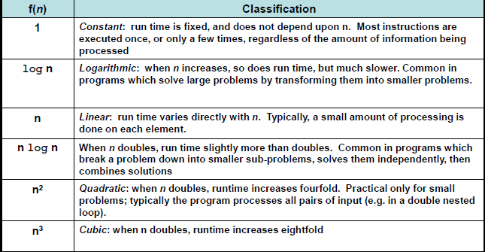
Performance Classification

Slide 42
Why are asymptotic notations important?
They give a simple characterization of an algorithm’s efficiency.
They allow the comparison of the performances of various
algorithms.
For large values of components/inputs, the multiplicative
constants and lower order terms of an exact running time are
dominated by the effects of the input size (the number of
components).

Slide 43
What is Asymptote?
Provides a behavior in respect of other function for varying value of input size.
An asymptote is a line or curve that a graph approaches but does not intersect.
An asymptote of a curve is a line in such a way that distance between curve and line approaches zero towards large values or infinity.

Slide 44
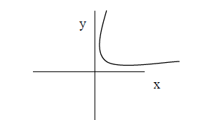
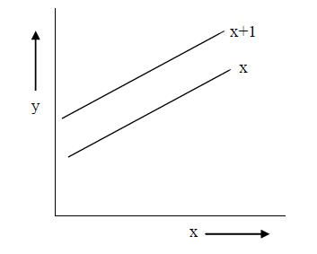

Slide 45
Asymptotic Notations
Asymptotic notations (as n tends to infinity) - used to express the running time of an algorithm in terms of function, whose domain is the set of natural numbers N={1,2,3,…..}. These are:
O (Big – Oh)
[This notation is used to express Upper bound (maximum steps) required to solve a problem] -- worst case growth of algorithm)
Ω (Big – Omega)
[This notation is used to express Lower bound i.e. minimum (at least) steps required to solve a problem] -- Best case growth of algorithm)
Θ (Big - Theta)
[Used to express both Upper & Lower bound, also called tight bound] -- (i.e. Average case)

Slide 46
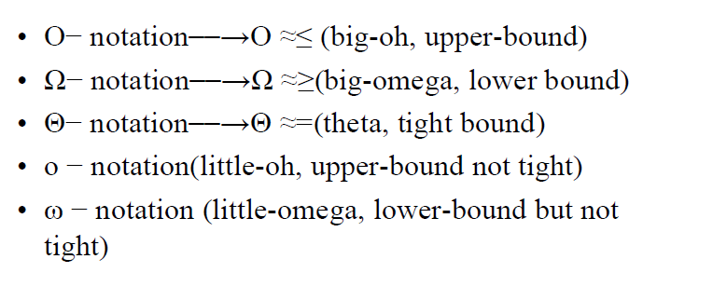
Asymptotic Notations

Slide 47
Asymptotic Notations
O notation: asymptotic “less than”:
  f(n)=O(g(n)) implies: f(n) “≤” g(n)
Ω notation: asymptotic “greater than”:
  f(n)= Ω (g(n)) implies: f(n) “≥” g(n)
Θ notation: asymptotic “equality”:
  f(n)= Θ (g(n)) implies: f(n) “=” g(n)

Slide 48
Asymptotic Analysis
Finding the exact complexity, f(n) = number of basic operations, of an algorithm is difficult.
We approximate f(n) by a function g(n) in a way that does not substantially change the magnitude of f(n).
This "approximate" measure of efficiency is called asymptotic complexity.
Thus the asymptotic complexity measure does not give the exact number of operations of an algorithm, but it shows how that number grows with the size of the input.
In particular, we study tight bounds, upper bounds and lower bounds.

Slide 49
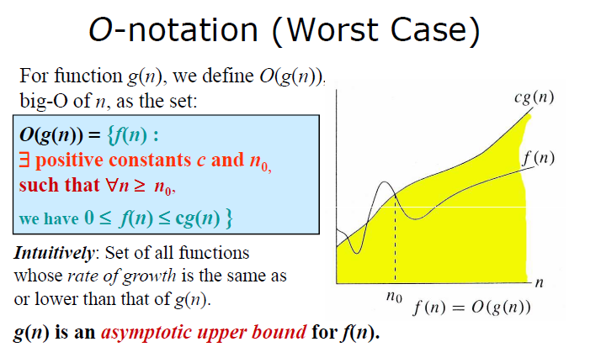

Slide 50
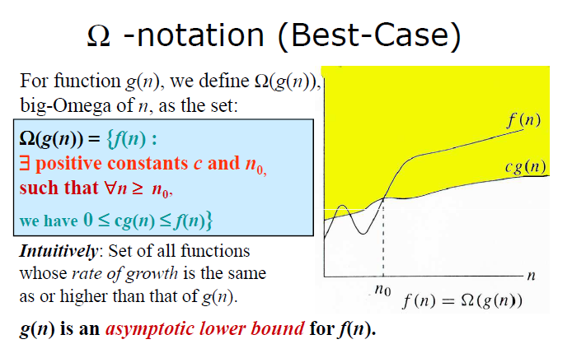

Slide 51
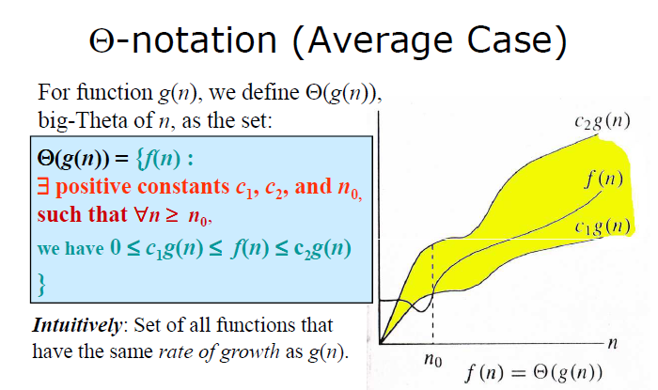

Slide 52
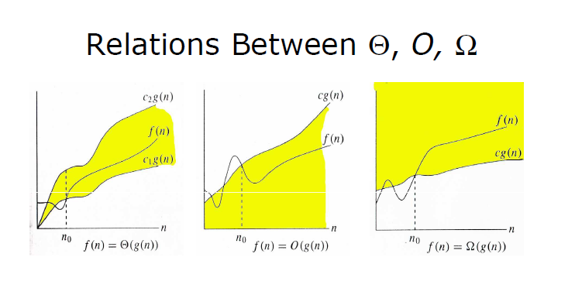

Slide 53
Asymptotic – Summary
A way to describe behavior of functions in the limit.
Describe growth of functions.
Focus on what’s important by abstracting away low order terms and constant factors.
Indicate running times of algorithms.
A way to compare “sizes” of functions.
Examples:
– n steps vs. n+5 steps
– n steps vs. n2 steps
Running time of an algorithm as a function of input size n for large n.
Expressed using only the highest-order term in the expression for the exact running time.

Slide 54
Asymptotic Order of Growth
A way of comparing functions that ignores constant factors and small input sizes
O(g(n)): class of functions f(n) that grow no faster than g(n)
Θ(g(n)): class of functions f(n) that grow at same rate as g(n)
Ω(g(n)): class of functions f(n) that grow at least as fast as g(n)

Slide 55
Rate of Growth
Consider the example of buying elephants and goldfish:
Cost: cost_of_elephants + cost_of_goldfish
Cost ~ cost_of_elephants (approximation)
The low order terms in a function are relatively
insignificant for large n
n⁴ + 100n² + 10n + 50 ~ n⁴
i.e., we say that n⁴ + 100n² + 10n + 50 and n⁴ have the same rate of growth

Slide 56
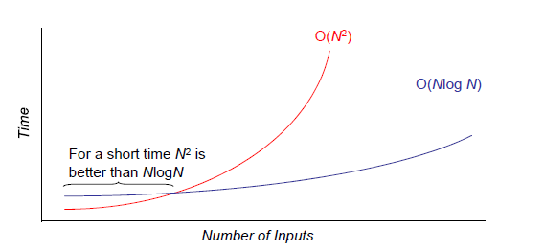
Growth Rates

Slide 57
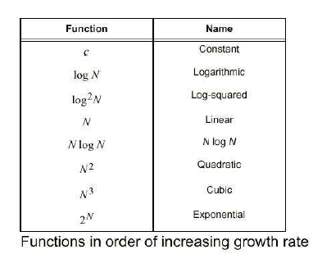
Function of Growth Rate

Slide 58
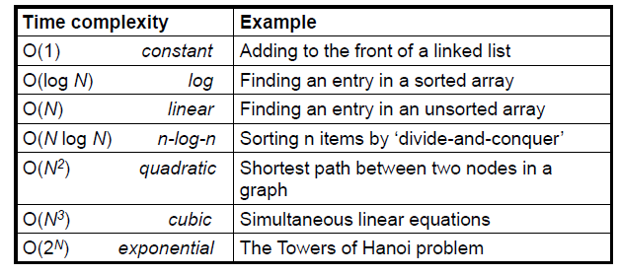
Common Growth Rates

Slide 59
Growth of functions
Asymptotic efficiency of algorithm – order of growth of algorithm as i/p size approaches limit
f() & g()
f(20) vs g(20), f(20000) vs g(20000)
Which algorithm is faster??
For any n > c (constant), f(n) >= g(n) or g(n) >=f(n)
Say c = 20. Easy to predict bounds rather than exact speed.

Slide 60
Visualizing Orders of Growth
On a graph, as
you go to the
right, a faster
growing
function
eventually
becomes
larger...
f_{A}(n)=30n+8
Value of function →
f_{B}(n)=n²+1
Increasing n →

Slide 61
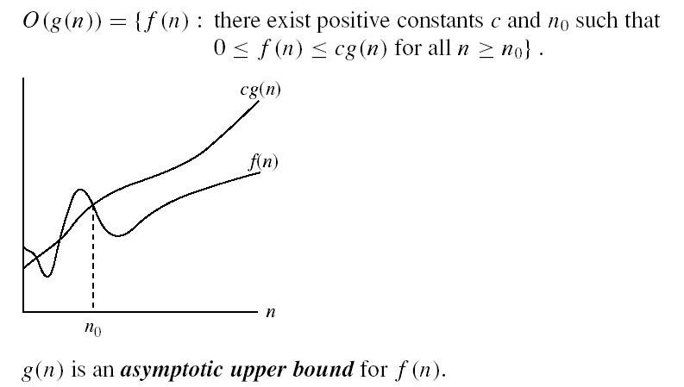
Big Oh (O) Notation
O-notation

Slide 62
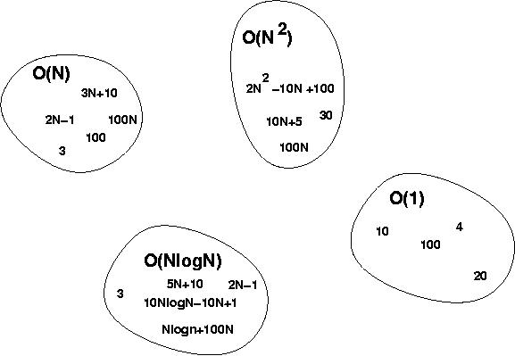
Big-O Visualization
O(g(n)) is the set of functions with smaller or same order of growth as g(n)

Slide 63
Examples
  2n² = O(n³):
  n² = O(n²):
  1000n²+1000n = O(n²):
  n = O(n²):
2n² ≤ cn³ ⇒ 2 ≤ cn ⇒ c = 1 and n₀= 2
n² ≤ cn² ⇒ c ≥ 1 ⇒ c = 1 and n₀= 1
1000n²+1000n ≤ 1000n²+ n² =1001n²⇒ c=1001 and n₀ = 1000
n ≤ cn² ⇒ cn ≥ 1 ⇒ c = 1 and n₀= 1

Slide 64
More Examples …
n⁴ + 100n² + 10n + 50 is O(n⁴)
10n³ + 2n² is O(n³)
n³ - n² is O(n³)
constants
  10 is O(1)
  1273 is O(1)

Slide 65
More Examples
Show that 30n+8 is O(n).
  Show ∃c,n₀: 30n+8 ≤ cn, ∀n>n₀ .
    Let c=31, n₀=8. Assume n>n₀=8. Then
    cn = 31n = 30n + n > 30n+8, so 30n+8 < cn.

Slide 66
Big-O example, graphically
Note 30n+8 isn’t
less than n
anywhere (n>0).
It isn’t even
less than 31n
everywhere.
But it is less than
31n everywhere to
the right of n=8.
cn =
31n
30n+8
30n+8
∈O(n)
Value of function →
n
n>n₀=8 →
Increasing n →

Slide 67
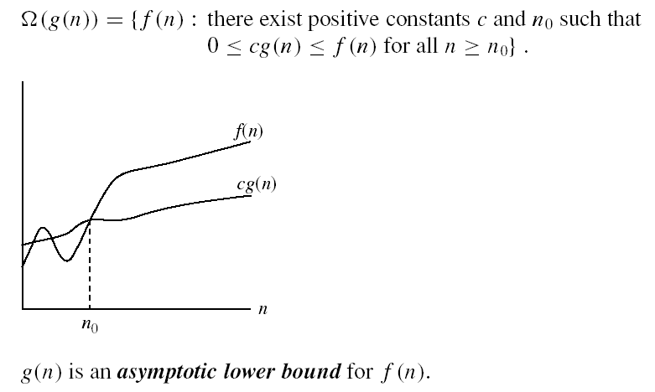
Big Omega (Ω) Notation
Ω - notation
Ω(g(n)) is the set of functions with larger or same order of growth as g(n)

Slide 68
Examples
  5n² = Ω(n)
  100n + 5 ≠ Ω(n²)
  n = Ω(2n), n³ = Ω(n²), n = Ω(logn)
  ∃ c, n₀ such that: 0 ≤ cn ≤ 5n²
⇒ cn ≤ 5n²
⇒ c = 1 and n₀ = 1
∃ c, n₀ such that: 0 ≤ cn² ≤ 100n + 5
100n + 5 ≤ 100n + 5n (∀ n ≥ 1) = 105n
cn² ≤ 105n
⇒ n(cn – 105) ≤ 0
Since n is positive ⇒ cn – 105 ≤ 0
⇒ n ≤ 105/c
⇒ contradiction: n cannot be smaller than a constant

Slide 69


Big Theta (Θ) Notation
Θ-notation
Θ(g(n)) is the set of functions with the same order of growth as g(n)

Slide 70
Examples
  n²/2 –n/2 = Θ(n²)
    ½ n² - ½ n ≤ ½ n² ∀n ≥ 0 ⇒ c₂= ½
    ½ n² - ½ n ≥ ½ n² - ½ n * ½ n ( ∀n ≥ 2 ) = ¼ n² ⇒ c₁= ¼
  n ≠ Θ(n²): c₁ n² ≤ n ≤ c₂ n²
  ⇒ only holds for: n ≤ 1/c₁

Slide 71
Examples
  6n³ ≠ Θ(n²): c₁ n² ≤ 6n³ ≤ c₂ n²
  ⇒ only holds for: n ≤ c₂ /6
  n ≠ Θ(logn): c₁ logn ≤ n ≤ c₂ logn
  ⇒ c₂ ≥ n/logn, ∀ n≥ n₀ – impossible

Slide 72
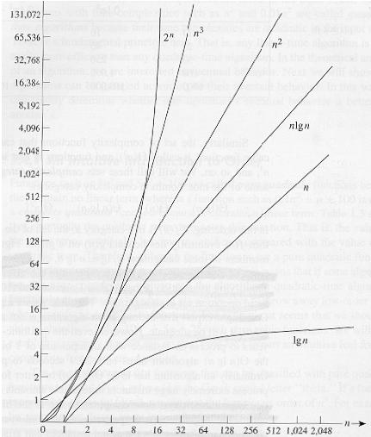
Common orders of magnitude

Slide 73
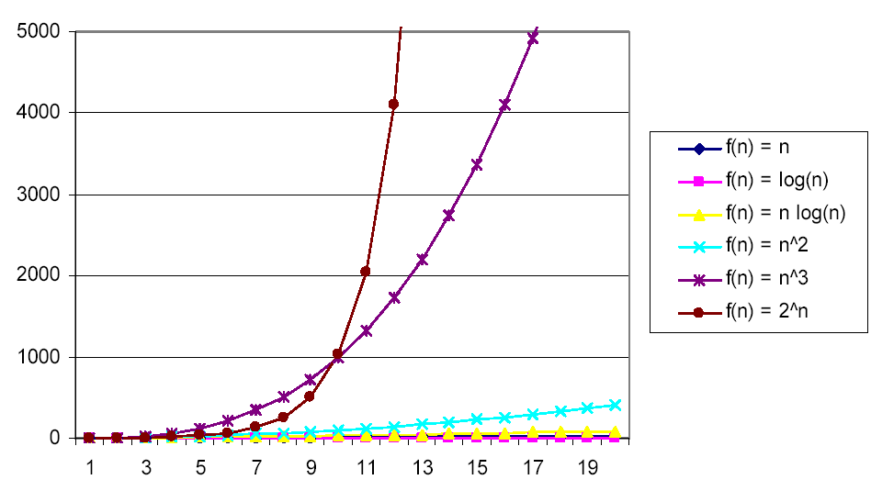
Common orders of magnitude

Slide 74
More Examples
For each of the following pairs of functions, either f(n) is O(g(n)), f(n) is Ω(g(n)), or f(n) = Θ(g(n)). Determine which relationship is correct.
  f(n) = log n²; g(n) = log n + 5
  f(n) = n; g(n) = log n²
  f(n) = log log n; g(n) = log n
  f(n) = n; g(n) = log² n
  f(n) = n log n + n; g(n) = log n
  f(n) = 10; g(n) = log 10
  f(n) = 2^{n}; g(n) = 10n²
  f(n) = 2^{n}; g(n) = 3^{n}
f(n) = Θ (g(n))
f(n) = Ω(g(n))
f(n) = O(g(n))
f(n) = Ω(g(n))
f(n) = Ω(g(n))
f(n) = Θ(g(n))
f(n) = Ω(g(n))
f(n) = O(g(n))

Slide 75
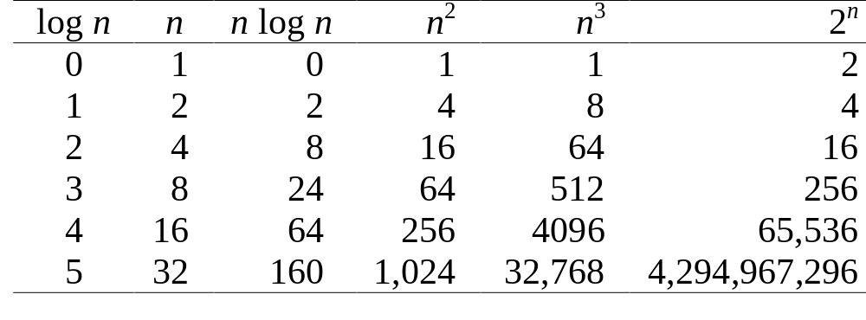
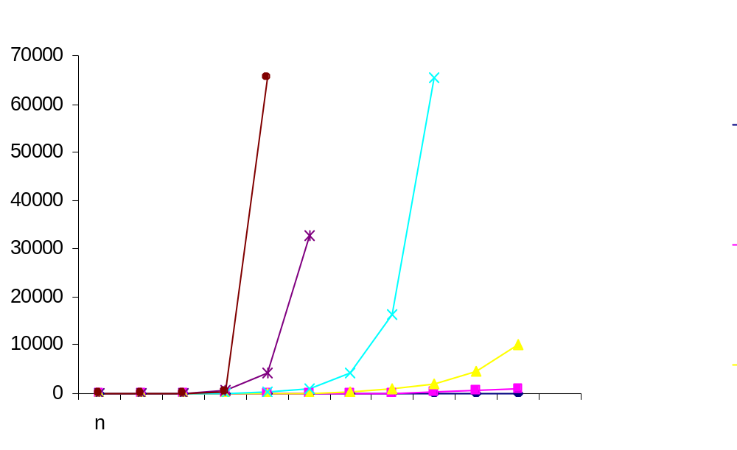
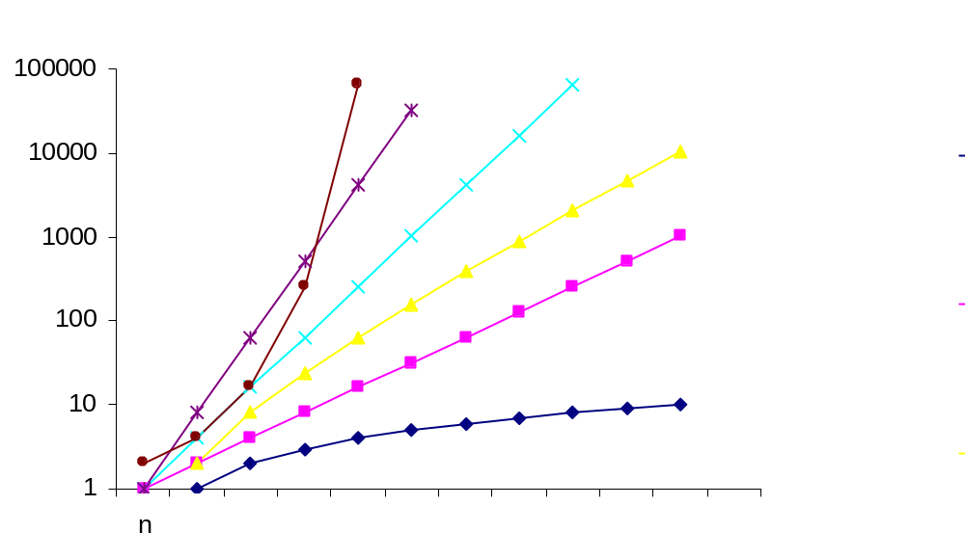
2^{n}
n²
2^{n}
n³
n²
n log n
n³
n
n log n
log n
n
log n

Slide 76
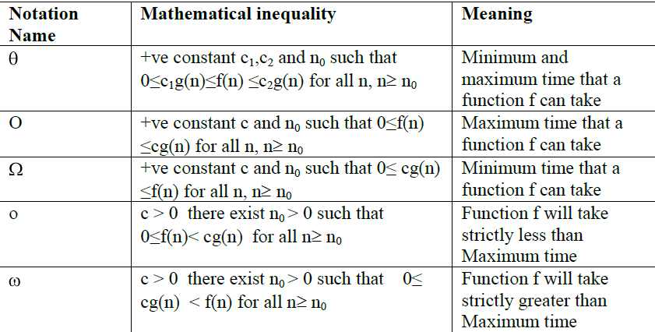

Slide 77

Problems – Big Oh, Big Omega, Big Thetha
First two functions are linear and hence have a lower order of growth than g(n) = n2, while the last one is quadratic and hence has the same order of growth as n2
Functions n3 and 0.00001n3 are both cubic and hence have a higher order of growth than n2, and so has the fourth-degree polynomial n4 + n + 1

Slide 78

Problems – Big Oh, Big Omega, Big Thetha
Ω(g(n)), stands for the set of all functions with a higher or same order of growth as g(n) (to within a constant multiple, as n goes to infinity).
Θ(g(n)) is the set of all functions that have the same order of growth as g(n) (to within a constant multiple, as n goes to infinity). Every quadratic function an2 + bn + c with a > 0 is in Θ(n2).

Slide 79
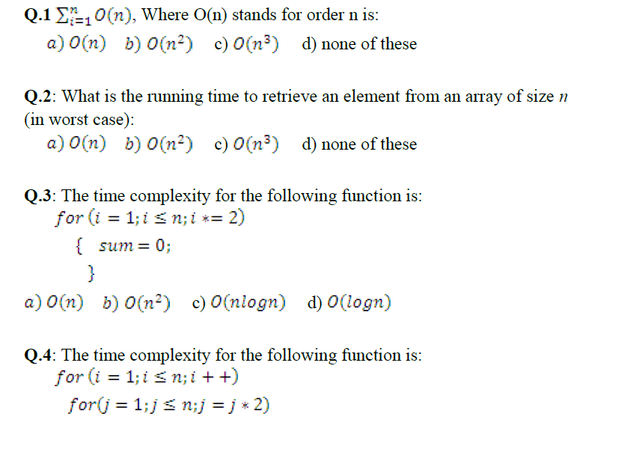
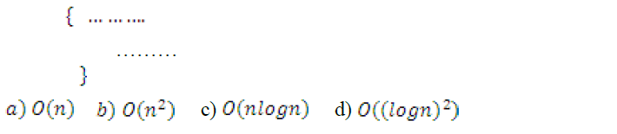
Exercise

Slide 80
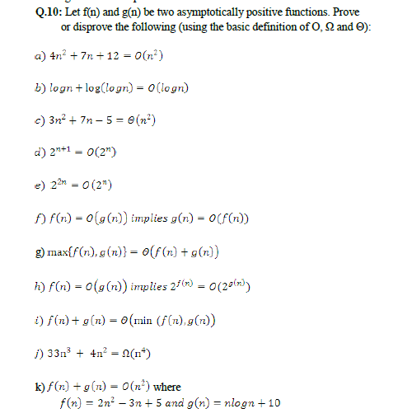

Slide 81
Mathematical Induction
Proof by using Mathematical Induction of a given statement (or formula), defined on the positive integer N, consists of two steps:
1. (Base Step): Prove that S(1) is true
2. (Inductive Step): Assume that S(n) is true, and prove that S(n+1) is true for all n>=1

Slide 82
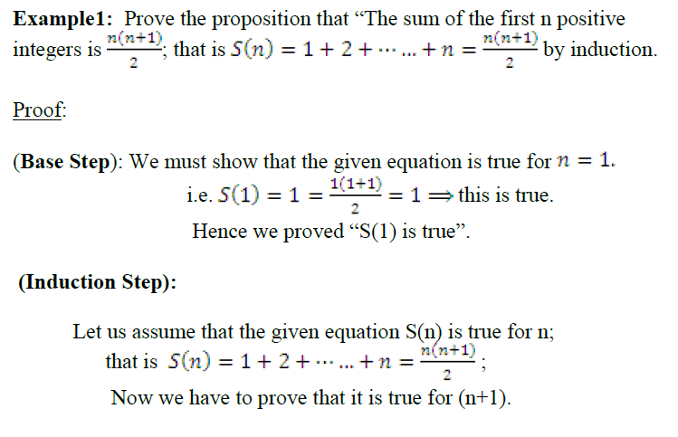
Mathematical Induction - Example

Slide 83
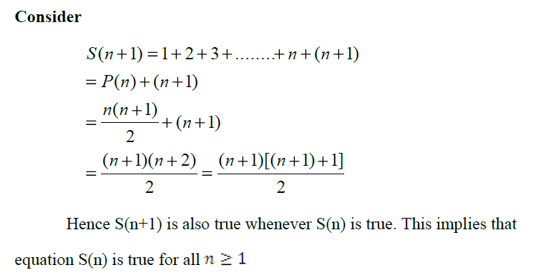
Mathematical Induction - Example

Slide 84
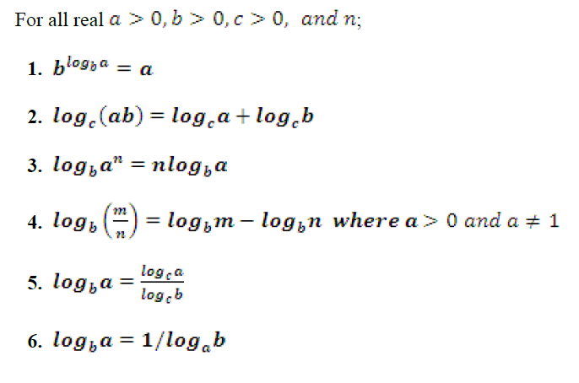


Logarithmic Formulae - Revisit

Slide 85
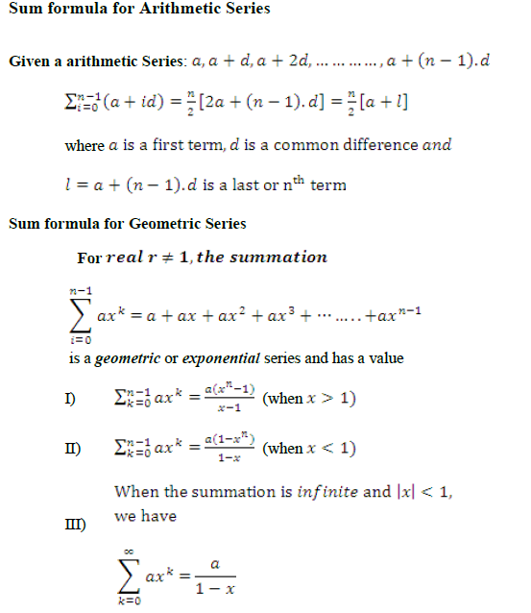

Slide 86
Any Question?
Thank you
for your attention.

